Slide 1
EASTVALLEY Counselors
Prof. School Counselors: Mrs. James and Mrs. Boyle
Mrs. Boyle and I hope everyone is doing well, safe and healthy!
WELCOME to week two of virtual learning. This week short lesson focuses on the book Wilma Jean the Worry Machine everyone has worries as the world around us is changing. The last part of the lesson has Mindfulness relaxation for kids activity.

Slide 2
WELCOME! To Storytime with the Counselors
Welcome to Storytime with the counselors.
SEL Learning #2: K-5th Grades
Hello, Eastvalley Students.

Slide 4
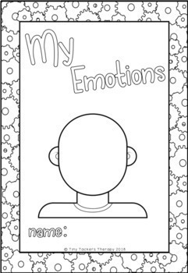
K-2nd Grades
My Emotions (Feelings):
Directions: Take out a piece of paper and draw a picture of how you look when you are worried and one when you are happy.
****************************
-Practice this Mindfulness activity*
-Star Breathing (Last Slide)

Slide 5
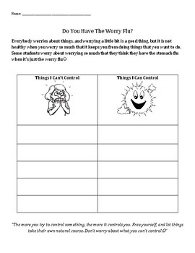
3rd -5th Grade Activity
Make goals for improving these things!
Make a list -
Things I Can’t Control
Things I Can Control
**************************
*Practice this Mindfulness activity*
-Star Breathing (Last Slide)
Grown-up issues
My thoughts
Other people’s
actions
My actions
Say “good-bye” to these things!

Slide 6
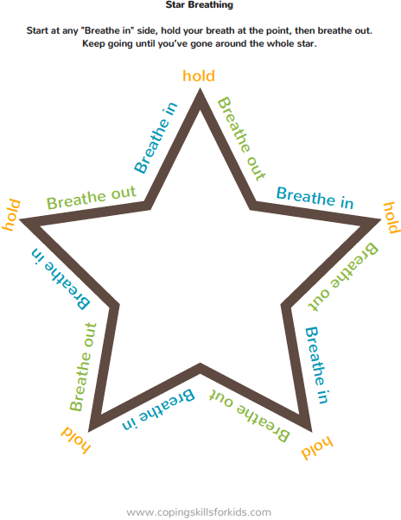
Draw a STAR and follow the directions.

